Slide 1
Hanger Dryer

Slide 2


Table of Contents
01
About Us
02
Product Design
03
Market Analysis
04
Marketing & Sales
05
Financial Analysis
06
Q & A

Slide 3


Buyer Persona
Benefit
Time-saving
Angelina
Concern
Sanitization and hygienic requirement cannot be met by school public drying machine
Age: 20
Occupation: Student at UNC
Location: Live on campus dormitory
About Us | Product Design | Market Analysis | Marketing & Sales | Financial Analysis

Slide 4
Mission Statement
“Propelled by a growing need to maintain sanitization during Covid-19, Hanger Dryer is expected to provide accessible and affordable dryers which can disinfect clothes for anybody in anyplace.”
About Us | Product Design | Market Analysis | Marketing & Sales | Financial Analysis

Slide 5






Our Team
Qingcheng Wei
Xingxin Guo
Manhui Zhu
Zihan Chu
CEO
CFO
CMO
HR
About Us | Product Design | Market Analysis | Marketing & Sales | Financial Analysis

Slide 6
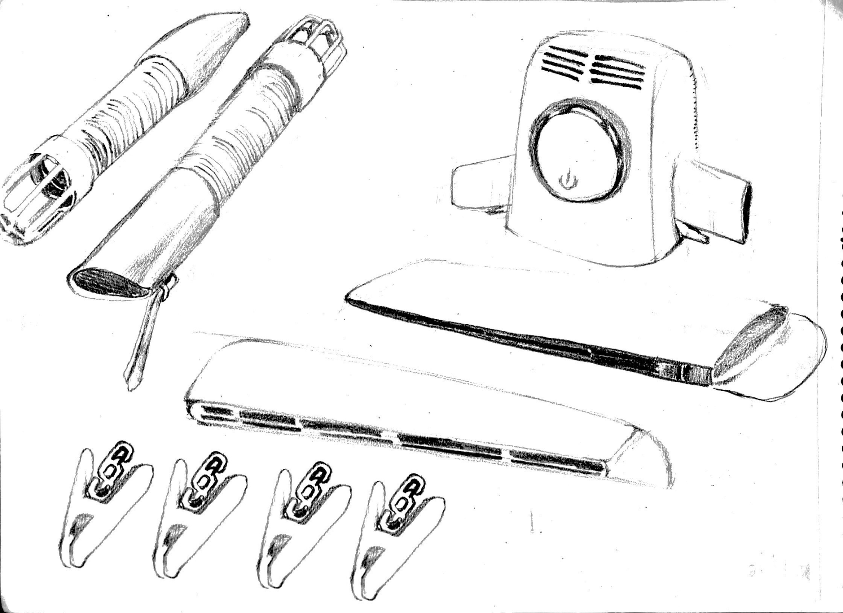
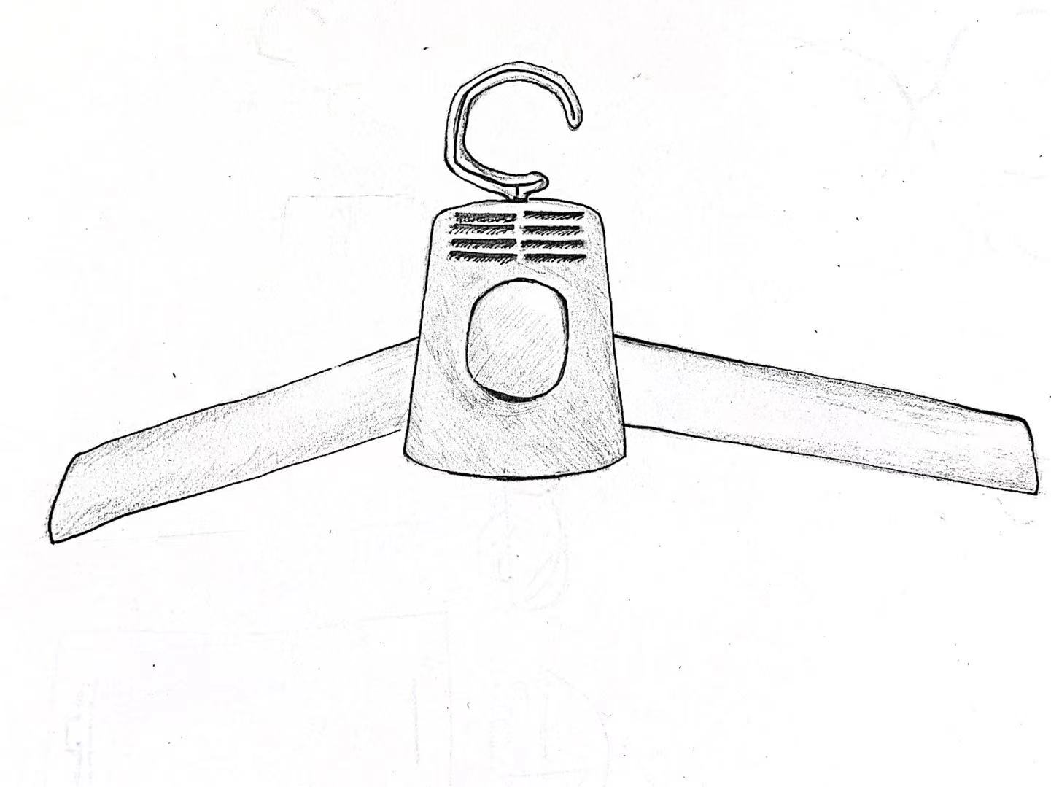



Product Design
01
Component
Main machine, two shoe tubes, two Clothes, tubes, and four clamps
02
Specification
Size: 42cm*20cm*8cm
Power Voltage: 150W
Load-bearing: 5 kg
03
Function
Drying clothes, anion sterilization, mite elimination, and odor removal
About Us | Product Design | Market Analysis | Marketing & Sales | Financial Analysis
Notes:
Here comes our second part: product design. Our product is a portable dryer machine in the shape of a clothes hanger. It is made of ABS plastic on the outside and contains many electronic components on the inside. The wire and plug are connected on the back of the main machine, so it will operate after plugging in. The product is detachable, according to the needs of consumers, they can dismantle and assemble tubes to the main machine based on their own habbits.
Hanger Dryer has a fashionable appearance, distinguished craftsmanship, and is easy to use. The dryer has hot and cold wind mode, drying the clothes by 50 to 60 degrees Celsius hot wind. We use PTC heating technology, which is more safe and efficient than traditional dryer machines. People should not worry about the safety of our product, since Hanger Dryer has three security protections: microcomputer control, overtemperature protection, and flame retardant materials. It also has close-fitting anion sterilization, mite elimination, and odor removal functions. I believe that our product can greatly facilitate our life. I’m confident that no one who has used it will regret buying it.
Let’s move to the market analysis part.

Slide 7

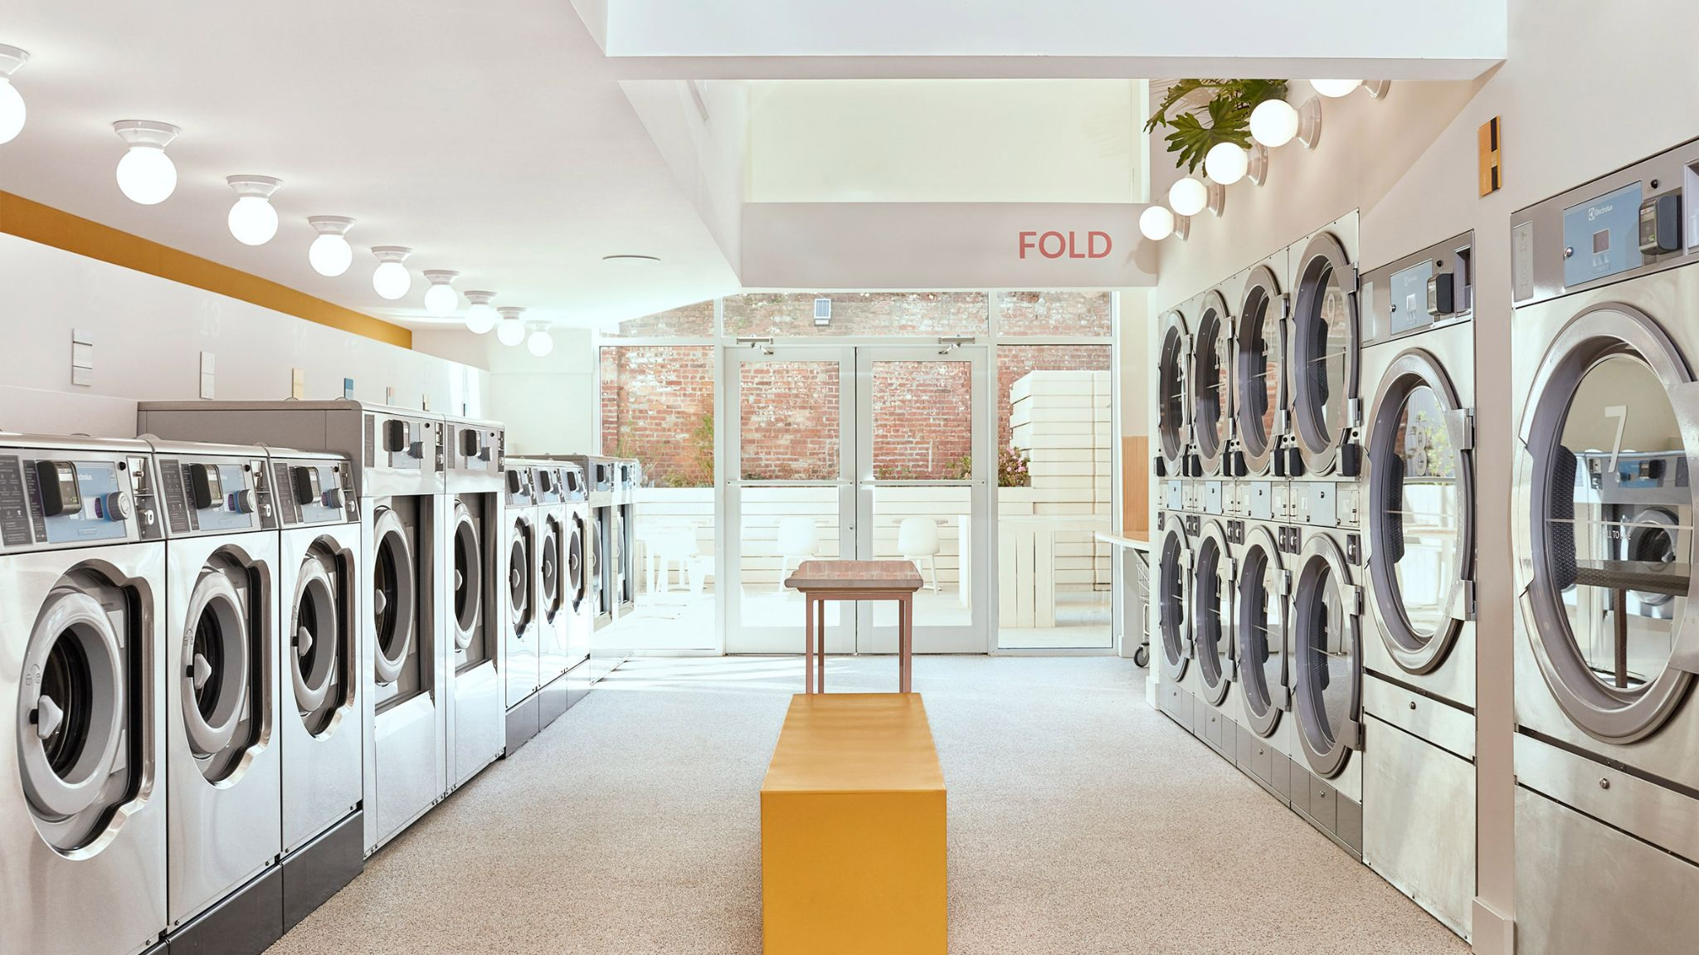


Competitive Analysis
Dryer Manufacturing
Laundromats
About Us | Product Design | Market Analysis | Marketing & Sales | Financial Analysis
Notes:
In this part, I will show you guys two main competitors in the field, and why we are special.
For Dryer Manufacturing, most consumers tend to feel more comfortable purchasing dryer machines from well-known brands that have a reputation for safety and reliability. But we should notice that the companies are facing technology innovation challenges to meet the demand for environmental protection with lower energy costs. Luckily, our Hanger Dryer can avoid this question, so that we are able to reach more targeted customers. Our product is not the traditional dryer machines people use in the household. Hanger Dryer is innovative in energy saving, which can help people to cater to the necessity of being environmentally friendly. Traditional dryer machines usually costs people 45min- 60min to dry people’s clothes, whereas Hanger Dryer only costs people 20-30 min to dry their clothes. Besides, Hanger Dryer can be folded and put in small luggage, so people can easily take it with them when they travel to short distances places. Therefore, instead of just using drying machines in the home or public places, people can enjoy a more convenient drying service anytime and anywhere by using Hanger Dryer.
For laundromats, the industry remains highly fragmented. As the Covid-19 pandemic came on quickly in the US, demand for industry services dropped off as individuals are limited to contact with each other as much as possible. Compared to the laundromats, Hanger Dryer has two main advantages. Firstly, consumers in laundromats use the dryer machines shared with others, but our product provides people with a more personal drying service. People can use our product to dry and sterilize their clothes anytime and anywhere, which is more friendly and safe in the epidemic period. Secondly, laundromats cost too much to update the machine, and in order to maintain quality of service, it is difficult to cut the expense on new machines. However, our products are sold online, so we don’t need to rent brick-and-mortar stores as the main sales and service places. We can also spend less on product assembly and company management, as we don’t need to employ as many people as big companies do.
These are the main advantages to show that we are better than others in this field. Now, let’s turn it over to the marketing and sales part.

Slide 8



Service Line
Individual
Online Selling
Target Market
Vending Machines
Hotel & Colleges
Businesses
Wholesale
$12/per one
Hotel: $0.5/per hour
University: $0.3/per hour
About Us | Product Design | Market Analysis | Marketing & Sales | Financial Analysis
Notes:
We have three service lines. We will decide our based on people’s disposable income.

Slide 9

Target Customers
Individuals
Hotels & Colleges
Any businesses
Trade shows
Trusted Partnership
Ads on our website, app and vending machines
Influencers
(Instagram, TikTok, Youtube)
About Us | Product Design | Market Analysis | Marketing & Sales | Financial Analysis
Notes:
We have three categories of our products, the first is the average household, we are planning to rely on influencers in some mian video platforms like youtube, ticktok to advertise our products. They will provide a link of our product beside their videos.
The second biggest market is the hotel industry. Hotel usually has a large market of suppliers they can trust upon. we will attend the annual tradeshow to promote our products and co-op with any potential buyers. We will create our own facebook and twitter account to help them understand our products and values of the company. Besides, we will also build trusted partnership with specific hotel brands. The colleges will follow similar approach as the hotel industry. We will contact with the executives of schools to promote our products and send them samples.

Slide 10
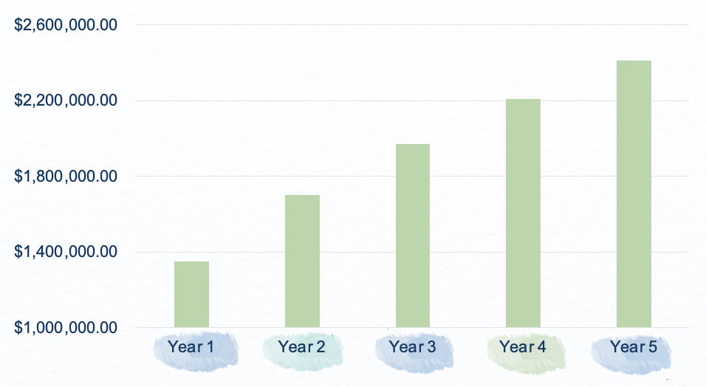
Profit
About Us | Product Design | Market Analysis | Marketing & Sales | Financial Analysis
Notes:
This is a graph of the estimated profit of Hanger Dryer for the next 5 years. Based on our service lines, the profit comes from three parts, which is individuals household,university, and hotel.
For retail targeted at individual households, we mainly utilize online selling channels. We predict online selling per month is 400 units in the first year of business. The cost includes manufacturing, advertising, customer service, and delivery fee etc.
For the market at universities and hotels, we will put out vending machines, which have 45 products in each of them We predict that the usage time per product per day is 6 hr, and we approximate 80% of products in each vending machine will be used every day.
Within the first year of business, we collaborate with 5 universities and 10 hotels. For each university, we plan to put out 10 vending machines in the campus dormitories. But for each hotel, we only plan to put out 2 vending machines. And for the following years, we will make agreements with more universities and hotels chains.
The cost components for the market of university and hotel are similar, including the expense of commission, vending machines, depreciation, maintenance, and manufacturing, etc.
It is obvious that the profit of year 2 has a substantial increase, because there is no initial cost of developing the product and building the website and application.

Slide 11
$200,000
Requesting for a $200,000 for 15% stake
About Us | Product Design | Market Analysis | Marketing & Sales | Financial Analysis
Notes:
Based on our first year profit, Hanger Dryer is requesting $200,000 in exchange for a 15% stake of the company.
We will use this money to put some vending machines in college dormitories and hotel lobbies, and cover the initial manufacturing sunk costs. Currently, we mainly focus on student dormitories and hotels in two college towns (Chapel Hill and Durham).
For the specific use of the fund, we plan to spend it on website and application development, marketing, manufacturing, product development, and commissions for universities and hotels.
As you see in the previous slide, the first year operating profit reaches $1.3 million. The profit growth in the next two years is expected to be around 20%. And for the following years, the profit growth will be around 10%. I believe hanger Dryer is a promising company. We are confident in our product, it fills a gap in the current market.
Compared to the traditional dryer machine, our product is time-saving, portable, and detachable. If you travel frequently or have many short business trips, you can put our product into the suitcase and use it anywhere. In the Covid-19 period, Hanger Dryer will provide you a secure and convenient private drying experience.

Slide 12
Thanks for your listening
Notes:
Thank you for listening to our pitch deck, I hope you have an overall understanding of Hanger Dryer. Next is the Q&A section, if you have any questions, please feel free to ask.

Slide 13
Question & Answer

